Slide 1
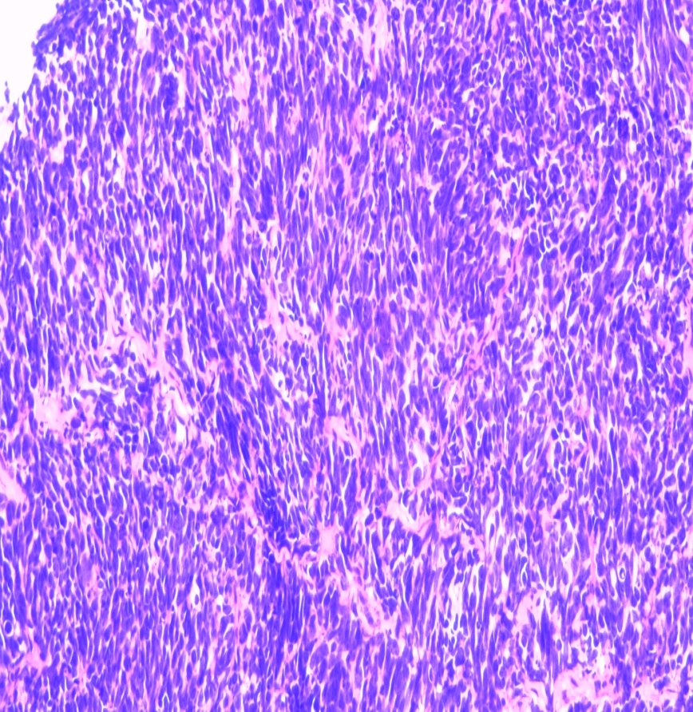
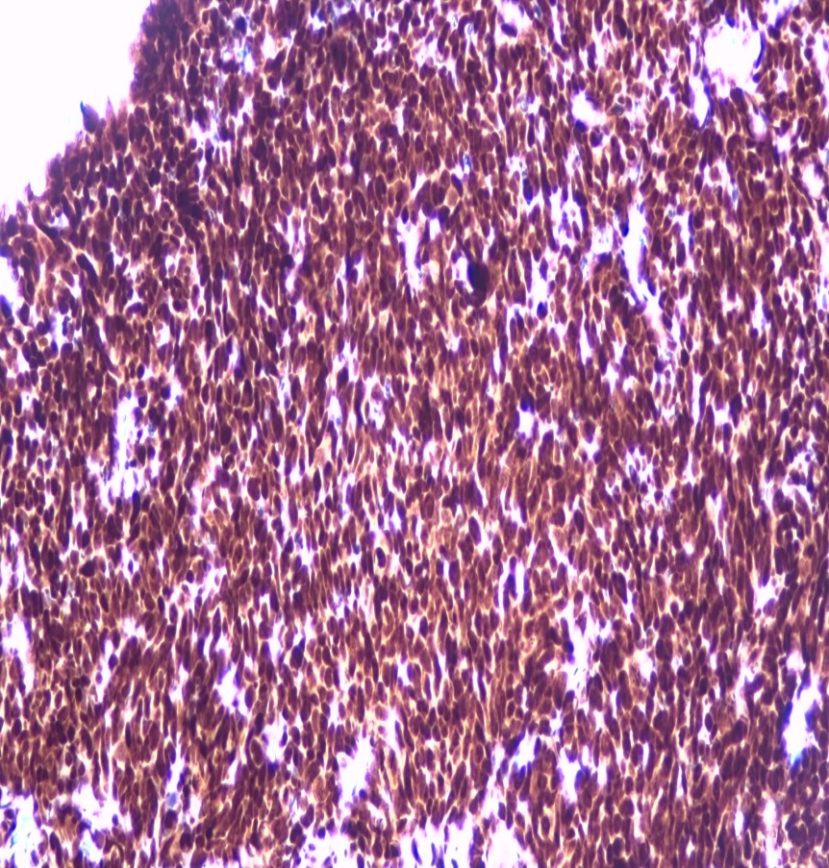
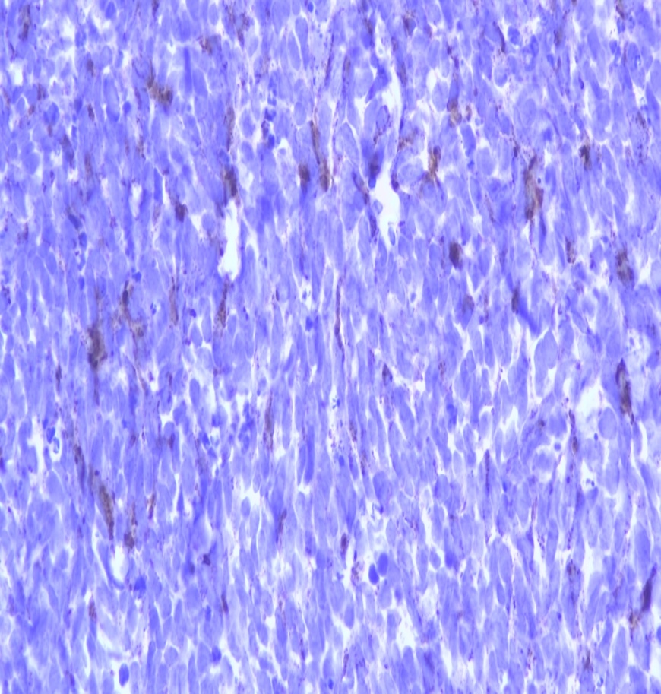
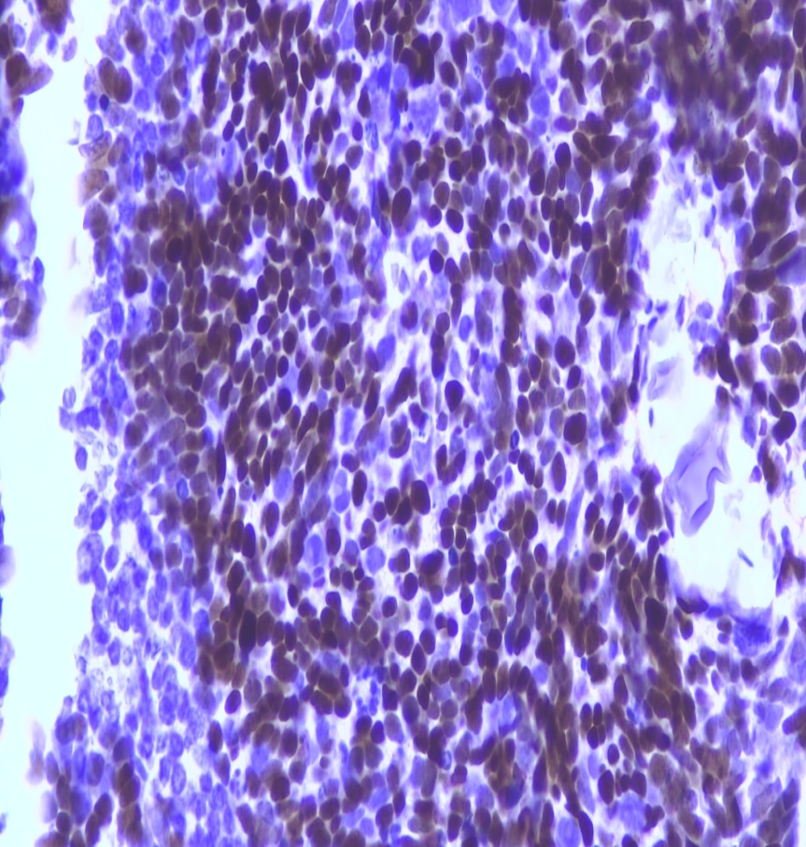
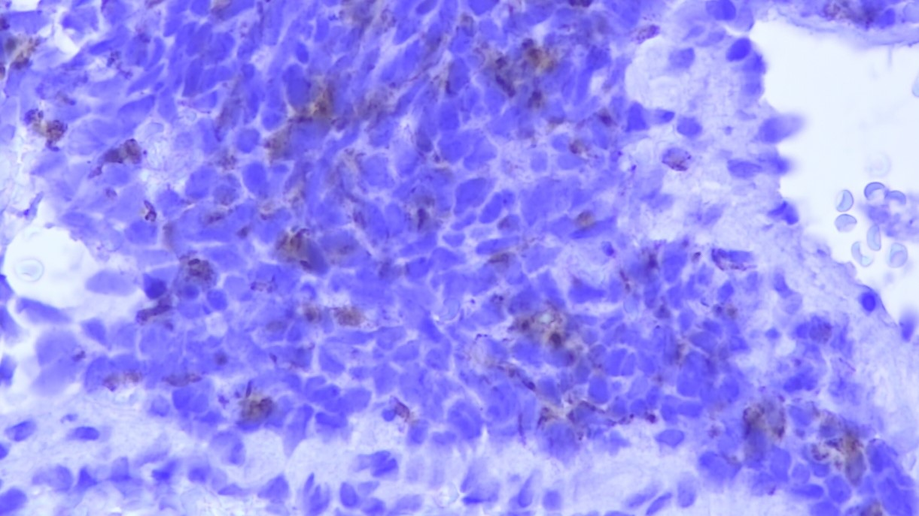
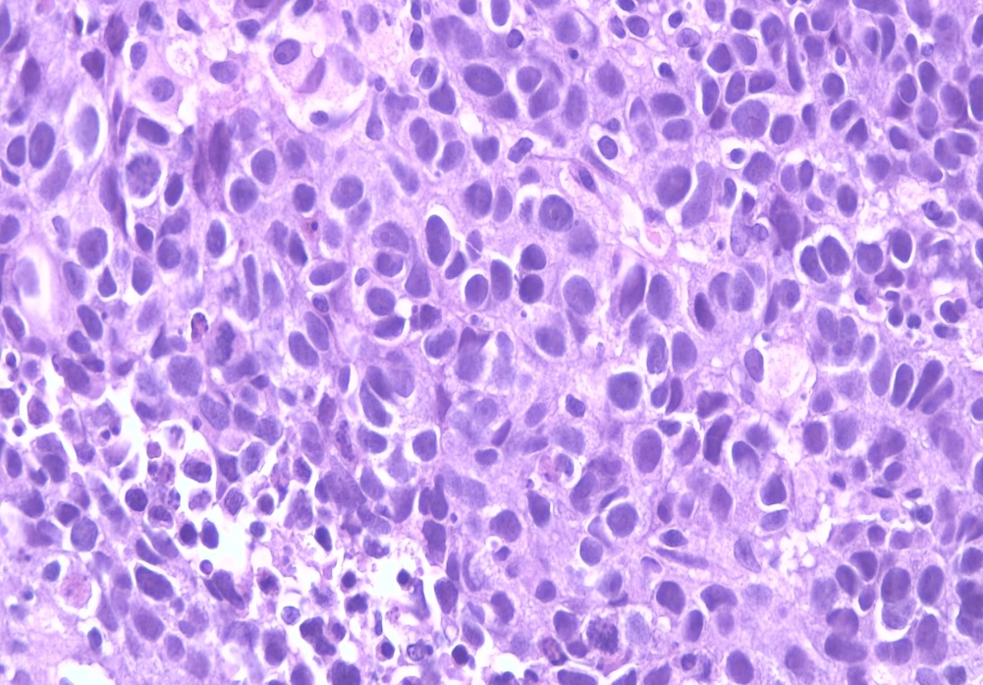
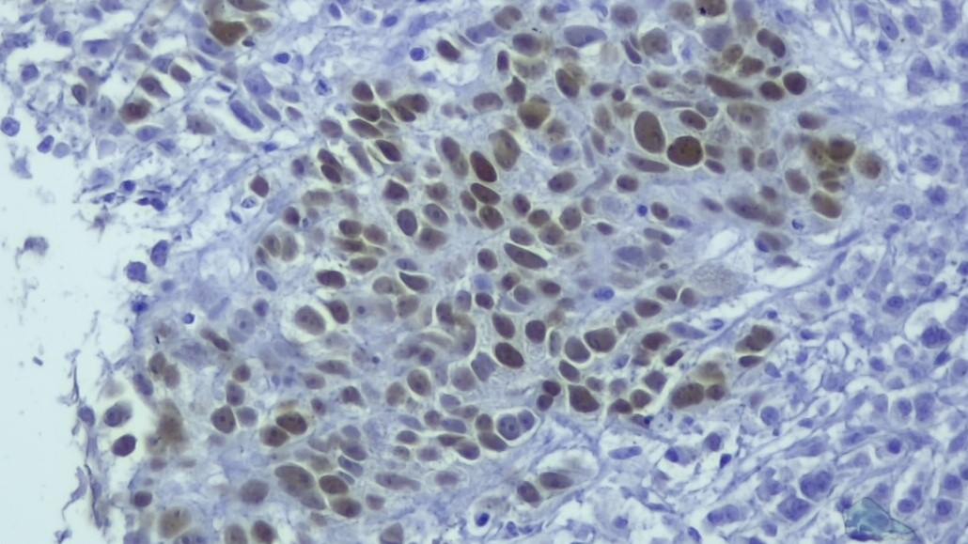
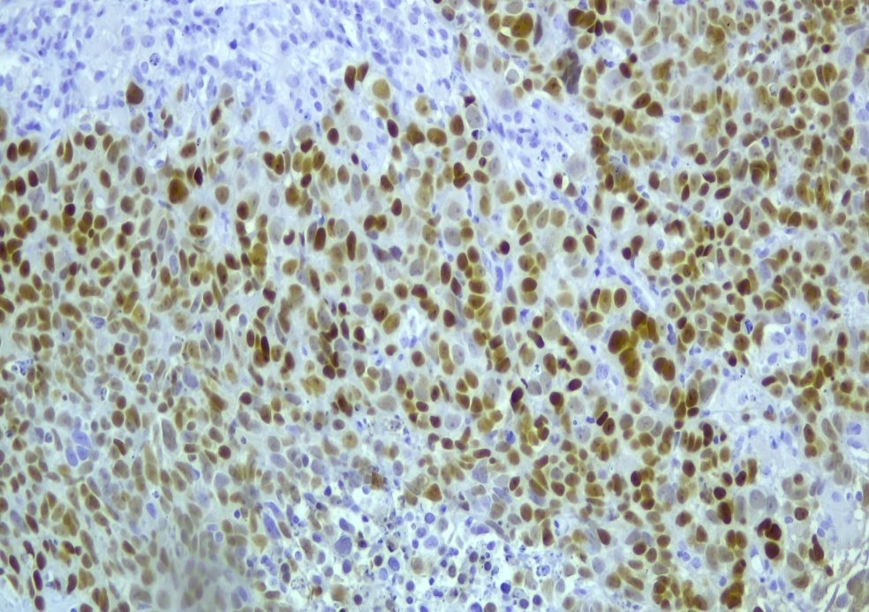
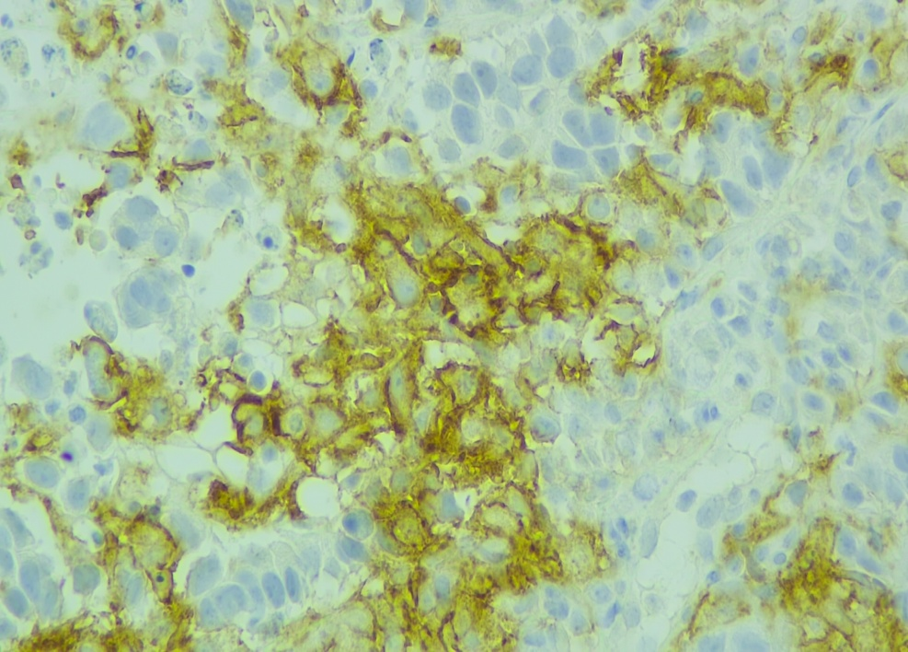
MUTATIONAL-COPY NUMBER VARIATION PROFILE AND IMMUNOTHERAPY DRIVERS IN NEUROENDOCRINE LUNG CARCINOMAS:
PD-L1, MICROSATELLITE INSTABILITY, DNA MISMATCH REPAIR GENES EXPRESSION AND TUMOR MUTATIONAL BURDEN IN A SERIES OF 30 CASES.
Natalia Rodon¹, Carme Pubill^{1,2}, Yessica No¹, Estefanía García³, Eugeni Saigi³ and Xavier Puig^{1,2,4}.
¹BIOPAT. Biopatologia Molecular SL. Grup Assistència. Barcelona, Spain, ²HISTOPAT SL. Barcelona, Spain. Servicios de ³Oncologia y ⁴Patología. SCIAS-Hospital de Barcelona, Grup Assistència. Barcelona, Spain.
INTRODUCTION
Immunotherapy, with treatments aimed at inhibiting immune checkpoints, has meant a paradigm shift in the therapeutic approach to solid neoplasms. The biomarkers postulated to indicate this type of treatment have been the PD-L1 expression, the presence of microsatellite instability (H-MSI), loss of DNA mismatch repair genes (dMMR) expression and Tumor Mutational Burden (TMB) interpreted as the number of mutations detected per megabase of DNA analyzed (mut /Mb). In the present study, these four biomarkers as well as the mutational profile and copy number variations (CNV) status have been analyzed in a series of lung neuroendocrine carcinomas.
A
B
C
D
E
Figure 1. Lung neuroendocrine tumor H&E (A) and immunostaining for TTF1 (B), chromogranin (C), INSM1 (D) and PANK (E).
MATERIALS AND METHODS
A retrospective study was designed. Lung neuroendocrine neoplasms analyzed in our center between 2019 and June 2022 were included. The morphological and MMR expression diagnosis included the immunohistochemical study of TTF-1 (Novocastra), chromogranin (Cell Marque), synaptofisin (Cell Marque), INSM1 (Santa Cruz), PANK (Biolegend), PD-L1 (Roche), MLH1, MSH2, MSH6 and PMS2 (BD Pharmingen) (Figure 1). The molecular study was performed with two NGS panels: one for the analysis of alterations in 52 genes at DNA and RNA level (FOCUS. ThermoFisher); and a second NGS panel for TMB analysis (Oncomine TML. ThermoFisher). Mutations, CNV and gene fusions were recorded. The microsatellite instability study was performed by PCR and fragment analysis of 13 markers (TrueMark MSI Assay. ThermoFisher).
A
B
C
D
Figure 2. Lung neuroendocrine tumor with squamous cell carcinoma component: H&E (A) and immunostaining for p63 (B), INSM1(C) and PD-L1 (D).
RESULTS
Thirty lung neuroendocrine tumors were included (7,5% of all lung neoplasms studied in the indicated period): 27 small cell tumors and 3 large cell tumors. None were negative for synaptofosin and chromogranin simultaneously. Only 3 tumors showed PD-L1 expression (20%, 20% and 5%) all of them presented a combined pattern of squamous cell carcinoma (Figure 2) and TMB values of 11, 4 and 7 mut/Mb, respectively: in two of these cases neither mutation nor CNV were detected. The third one showed a TP53 mutation and MYCL amplification. In the global series, non informative NGS panels results were obtained in one case due to the presence of deamination in the DNA extracted. Mutations in TP53, RB1, HNF1A, NOTCH1, PTEN, ARID1A and STK11 genes were detected in 72,4%, 17,2%, 10,3%, 10,3%, 6,9%, 6,9% and 6,9% of patients, respectively. Mutations in 13 more genes were detected with a frequency of less than 4% (Figure 3). Ten patients (34,5%) showed a CNV involving MYC, RICTOR, TERT, PIK3CA, PDGFRA, KIT and MYCL genes. No alteration was detected at RNA level. None of the analyzed tumors presented H-MSI or dMMR. The range of TMB values ​​was from 0 to 18,8 mut/Mb with a mean of 7,8 mut/Mb. Eleven cases (37,9%) presented a TMB ≥ 10 mut/Mb (Figure 4).
%
Figure 3. Percentage of gene mutations and amplifications detected on the global series.
CONCLUSIONS
In this series of lung neuroendocrine carcinomas, TP53 and RB1 mutations are the most prevalent.
No tumors show H-MSI or dMMR.
Only three express PD-L1. TMB can predict a potential response to immunotherapy in 38% of the cases analyzed.
Figure 4. TMB and number of altered genes for each patient of the global series.
AMP Europe, 2023. Milan, Italy.

